Slide 1
Aws - codestar

Slide 2
AWS CodeStar enables you to quickly develop, build, and deploy applications on AWS. AWS CodeStar provides a unified user interface, enabling you to easily manage your software development activities in one place.
With AWS CodeStar, you can set up your entire continuous delivery toolchain in minutes, allowing you to start releasing code faster. AWS CodeStar makes it easy for your whole team to work together securely, allowing you to easily manage access and add owners, contributors, and viewers to your projects.
Each AWS CodeStar project comes with a project management dashboard, including an integrated issue tracking capability powered by Atlassian JIRA Software. With the AWS CodeStar project dashboard, you can easily track progress across your entire software development process, from your backlog of work items to teams’ recent code deployments. Visit here to learn more.

Slide 3
There is no additional charge for using AWS CodeStar. You only pay for the AWS resources that you provision for developing and running your application (for example, Amazon EC2 instances).
Benefits:
Start developing on AWS in minutes
Manage software delivery in one place
Work across your team securely
Choose from a variety of project templates

Slide 4
Start developing on AWS in minutes
AWS CodeStar makes it easy for you to set up your entire development and continuous delivery toolchain for coding, building, testing, and deploying your application code.
To start a project, you can choose from a variety of AWS CodeStar templates for Amazon EC2, AWS Lambda, and AWS Elastic Beanstalk.
You have the option to choose AWS CodeCommit or GitHub to use as your project’s source control.
You also have the option to edit your source code using one of several options including AWS Cloud9, Microsoft Visual Studio, or Eclipse.
After you make your selections the underlying AWS services are provisioned in minutes, allowing you to quickly start coding and deploying your applications.

Slide 5
Manage software delivery in one place
AWS CodeStar provides an easy way to coordinate your day-to-day development activities through a unified user interface, reducing the need to switch between various service consoles.
AWS CodeStar’s project dashboard lets you monitor application activity, and track progress across all stages of your software development process, including code commits, builds, tests, and deployments, from a central place.
AWS CodeStar integrates Atlassian JIRA Software, a third-party issue tracking and project management tool, allowing you to easily manage JIRA issues directly in the AWS CodeStar dashboard.

Slide 6
Work across your team securely
AWS CodeStar enables you to collaborate on projects across your team in a secure manner.
You can easily manage access for project owners, contributors, and viewers without needing to manually configure your own policy for each service.
AWS CodeStar simplifies the process of setting up project access for teams by providing built-in role-based policies that follow AWS Identity and Access Management best practices.

Slide 7
Choose from a variety of project templates
With AWS CodeStar project templates, you can easily develop a variety of applications such as websites, web applications, web services, and Alexa skills.
AWS CodeStar project templates include the code for getting started on supported programming languages including Java, JavaScript, PHP, Ruby, C#, and Python.

Slide 8
Project templates
AWS CodeStar provides a number of project templates to help you quickly start developing applications for deployment on Amazon EC2, AWS Lambda, and AWS Elastic Beanstalk with support for many popular programming languages including Java, JavaScript, Python, Ruby, and PHP.
With AWS CodeStar, you can use a code editor of your choice such as Visual Studio, Eclipse, or the AWS Command Line Interface.

Slide 9
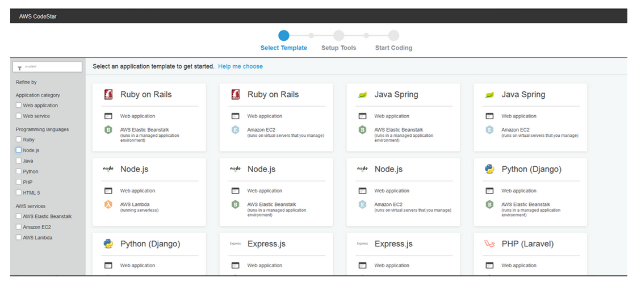

Slide 10
Team access management
AWS CodeStar uses AWS Identity and Access Management (IAM) to manage developer identities and provides built-in, role-based security policies that allow you to easily secure access to your team.
AWS CodeStar allows you to share your projects using three levels of access: owners, contributors, and viewers.

Slide 11
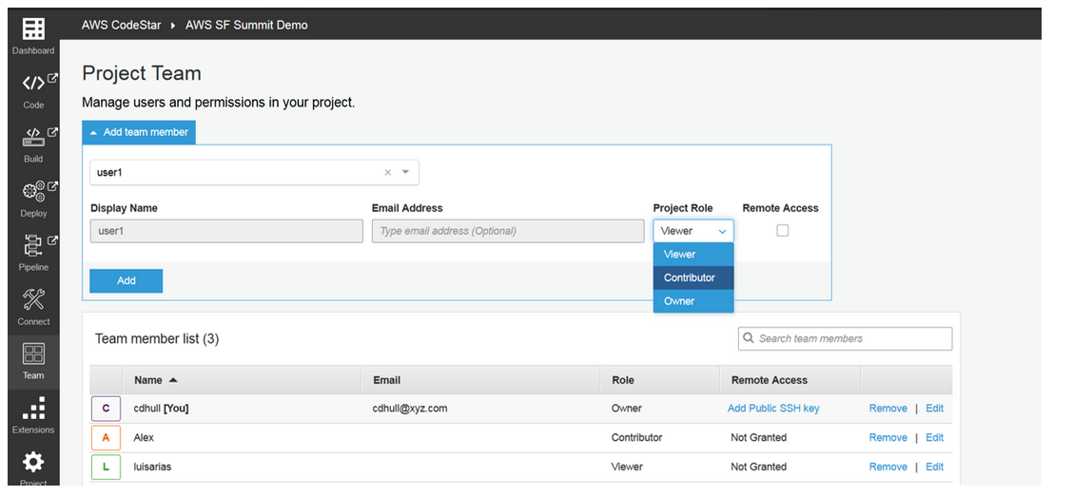

Slide 12
Hosted Git repository
AWS CodeStar stores your application code securely on AWS CodeCommit, a fully-managed source control service that eliminates the need to manage your own infrastructure to host Git repositories. You can also choose to have your project source code stored in a GitHub repository in your own GitHub account.
Fully managed build service
AWS CodeStar compiles and packages your source code with AWS CodeBuild, a fully-managed build service that makes it possible for you to build, test, and integrate code more frequently.
Automated continuous delivery pipeline
AWS CodeStar accelerates software release with the help of AWS CodePipeline, a continuous integration and continuous delivery (CI/CD) service. Each project comes pre-configured with an automated pipeline that continuously builds, tests, and deploys your code with each commit.

Slide 13
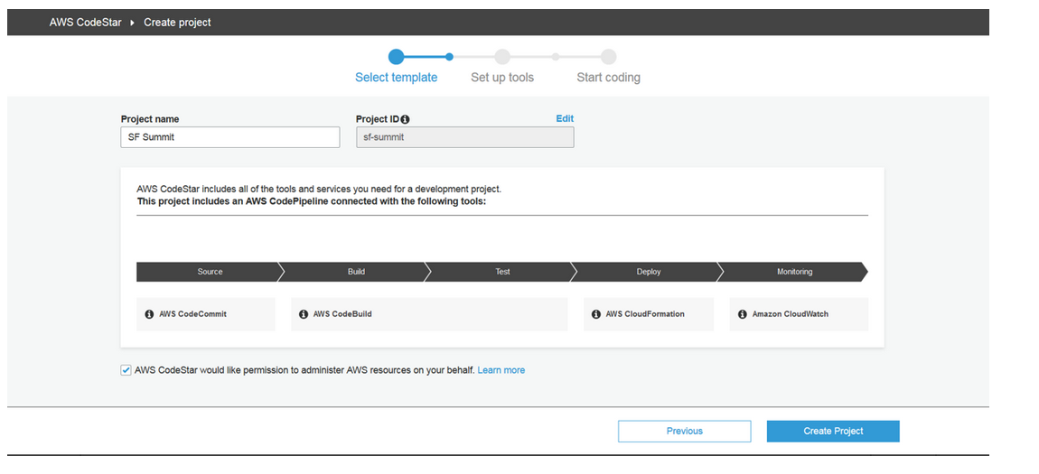

Slide 14
Automated deployments
AWS CodeStar integrates with AWS CodeDeploy and AWS CloudFormation so that you can easily update your application code and deploy to Amazon EC2 and AWS Lambda.
IDE integrations
After you create a project in AWS CodeStar, you can begin developing your code directly in AWS Cloud9, which makes it easy to get started developing on AWS. Cloud9 is a cloud-based IDE that lets you write, run, and debug your code with just a browser.
Cloud9 comes with a terminal that has a pre-authenticated AWS Command Line Interface giving you immediate access to a broad spectrum of AWS service. In addition to Cloud9, CodeStar allows you to pick from a number of other popular IDEs such as Microsoft Visual Studio and Eclipse.

Slide 15
Central project dashboard
AWS CodeStar projects include a unified dashboard, so you can easily track and manage your end-to-end development toolchain.
With the project dashboard, you can centrally manage activity for your CI/CD pipeline, such as code commits, builds, tests, and deployments and take remedial action where needed.
AWS CodeStar also includes a project wiki, making it easy for you to provide team information such as project links, code samples, and team notes.
AWS CodeStar also integrates with Amazon CloudWatch, an application monitoring service, and Atlassian JIRA Software, a third-party issue tracking and project management tool.
These integrations allow you to centrally monitor application activity and manage JIRA issues in the AWS CodeStar dashboard.

Slide 16
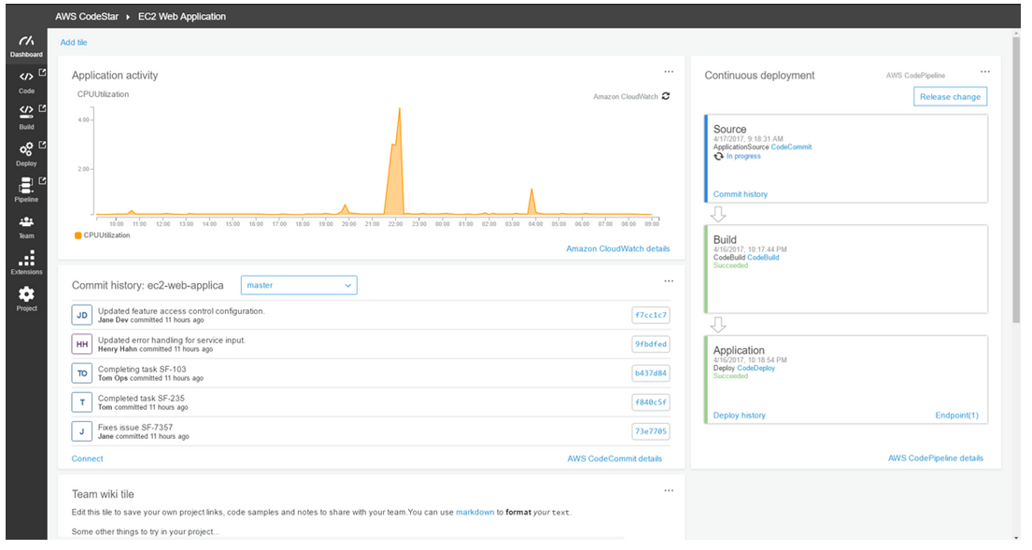

Slide 17
